Slide 1

Soil functioning

Slide 2
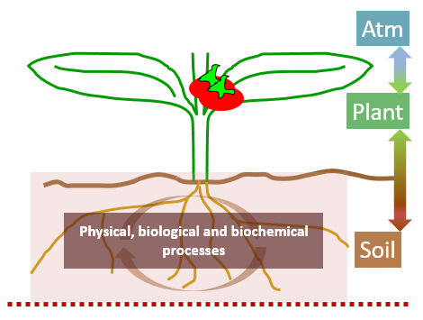
Outline
Soil compartments and parameters
Boundary conditions, initial conditions
Transfers (water, nitrate, heat)
Soil biogeochemistry (C and N transformations, fluxes)

Slide 3
Soil functionning 1. Soil compartments and parameters

Slide 4
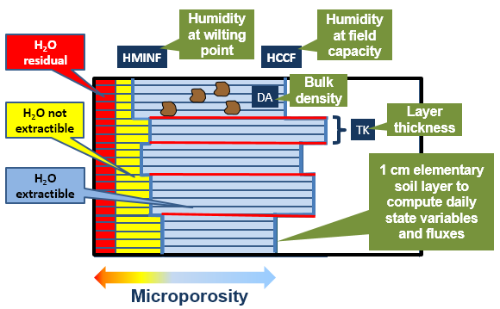
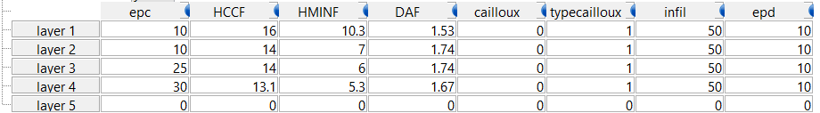
Soil layers
Up to five layers (~soil horizons) described in the soil input file
Surface parameters (clay content, pH, N content, CaCO3 + albedo, q0, ruisolnu…)
Layer specific parameters : DAF, hccf, hminf, cailloux, epd…
Elementary layers for computational purpose : 1 cm
Mixing cell thickness for nitrate dispersion (epd)
« active » layers : humification, denitrification
do not coincide necessarily with a soil layer
specific parameters (denitrification potential…)
General parameters (zesx, cfes, obstarac…)

Slide 5
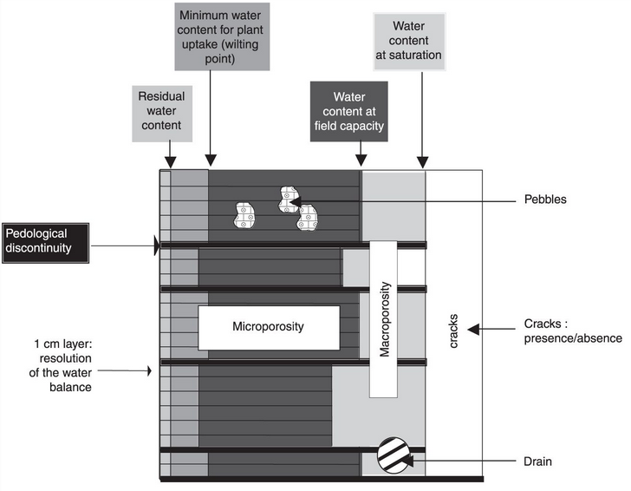
Soil compartments
Microporosity is mandatory, other compartment are optional
Macroporosity (codemacropor = 1)
= saturation – field capacity
active if infiltrability at the base of soil layers is limiting, control anoxia, useful to describe the effect of impedding layers (plow pan for ex)
2. Cracks (codefente = 1 & codemacropor = 1)
for swelling soils
3. Pebbles (codecailloux = 1)
4. Artificial drains (codedrainage = 1 & codemacropor = 1)
C and N pools (see later)

Slide 6
Soil functionning 2. Boundary and initial conditions

Slide 7
Boundary conditions
Soil surface
Water input through rainfall (- runoff), irrigation or losses through evaporation/transpiration
Air temperature (no heat flow calculation)
C and N inputs (mineral or organic fertilizers, residue, rainfall/irrigation…) or outputs (gaseous losses : NH3, N2O, (N2), N uptake
Bottom of soil profile
Water losses through drainage, or input through capillary rise
N losses through nitrate leaching
Modifications due to snow : preprocessing of climate data
Water is stored when snow accumulates and released later at melting
Isolation effect of the snow cover : effect on surface temperature

Slide 8
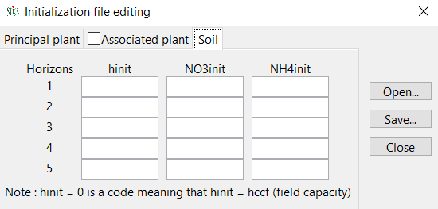
Initial conditions
Soil water: % gravimetric (!) for each layer; 0 means hccf
Soil mineral nitrogen : NH4, NO3, kg/ha
Choosing the best moment for initialization: no plant, known soil water content, mineral N profile available…

Slide 9
Soil functionning 3. Transfers (water, nitrate, heat)

Slide 10
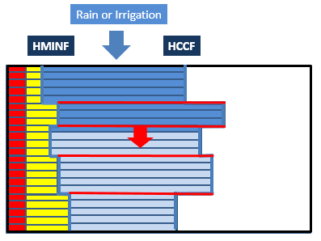
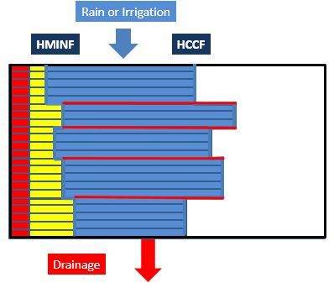
Water transfer
Non preferential downward flow
Reservoir analogy (reservoir = hccf - hminf)
Water entering the soil fills the elementary layers from top to bottom, assuming that the maximum soil water content of each layer is its field capacity (flow rate is not limited).
Drainage can occur when the whole profile is at field capacity
Soil water can only be removed from each elementary layer through evaporation and plant transpiration

Slide 11
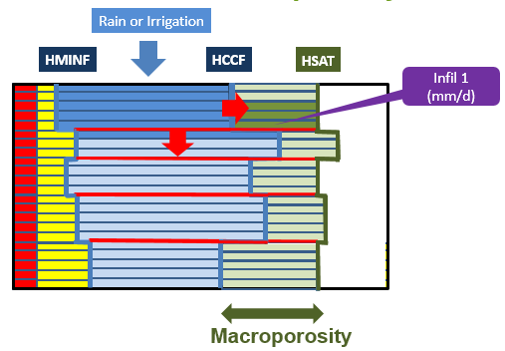
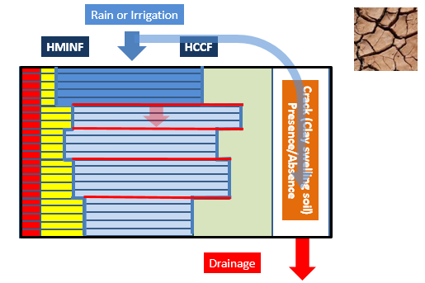
Water transfer
Macroporosity
Limiting infiltrability value at the base of soil layers (one or more)
When the deepest elementary layer of a soil layer is at field capacity, part of the excess water flow downward (at a rate equal to infiltrability), the remaining flows into macroporosity
-> progressive saturation from the bottom, anoxia
Cracks
unique compartment, extending from the soil surface to the maximum soil depth, which replaces the macroporosity
Only feeded from the surface
Direct pathway to drainage

Slide 12
Water transfer
WFPS option for nitrification and denitrification :
allows to take into account soil water content > field capacity and < saturation for the soil surface for days with rainfall
Rainfall saturates surface layers by filling the empty porosity until saturation
Progressive desaturation during the day until reaching soil water content at field capacity
Used for WFPS effect on N2O production/reduction processes
No output, only internal (does not affect transfers) !

Slide 13
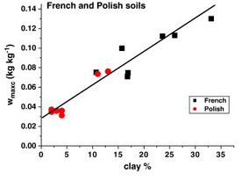
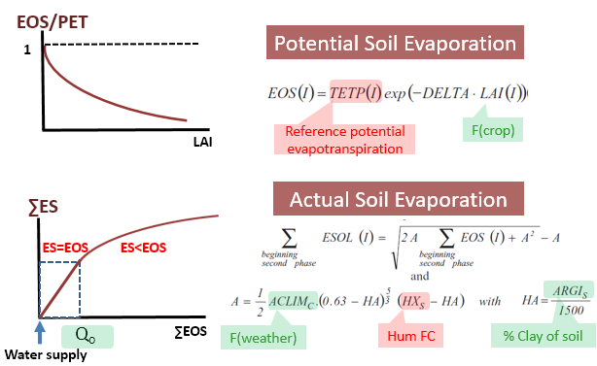
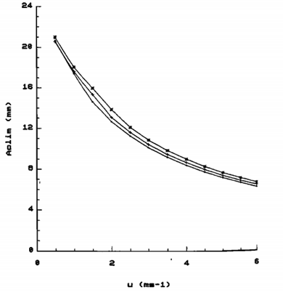
Water transfer
Better HA estimate:
Upward flow: evaporation
Potential evaporation depends on climatic demand and vegetative cover
Actual evaporation = 2 steps
ACLIM estimate:
0.63 to be corrected… -> soil porosity !

Slide 14
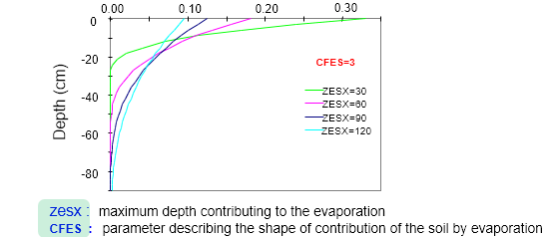
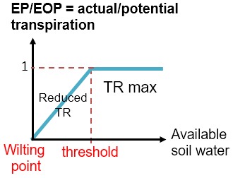
Water transfer
Evaporation profile
Maximum depth
Shape
Soil also influence transpiration :
Evaporation has priority on transpiration
Threshold of available water below which transpiration is reduced when the soil is drying

Slide 15
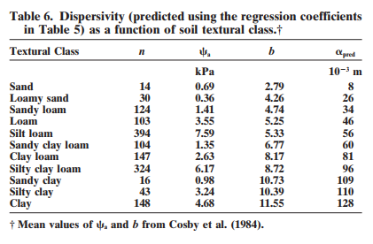
Nitrate transfer
Nitrate flows with water (convection)
Any nitrate arriving into an elementary layer mixes with the nitrate already present
Excess water flows downward with the new concentration of the mixture
Dispersion is taken into account through « mixing cells » which thickness (epd) is higher than elementary layer thickness
epd = 2 * α
Perfect et al. 2002

Slide 16
Heat transfer
No heat flow calculation!
Temperature at the soil surface is equal to tcult : determine the daily thermal amplitude
Tsol at depth z calculated by propagating the surface wave taking into account the exponential attenuation of the amplitude due to inertia

Slide 17
Soil functionning 4. Soil biogeochemistry (C and N transformations, fluxes)

Slide 18
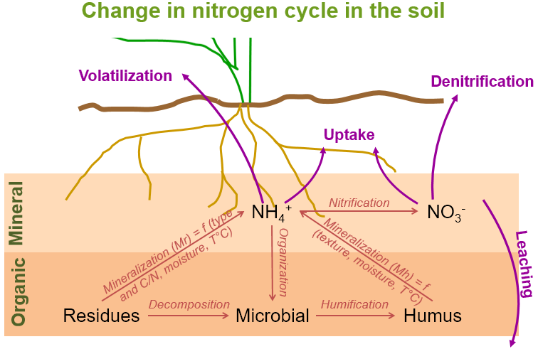
C N transformations
Different pools that are related
Active layers (prohhum, profdenit)
Interaction with transfers (local conditions, transport)
Potential rate + modulation by substrate availability & environmental conditions (temperature, water content, aeration, pH…)

Slide 19
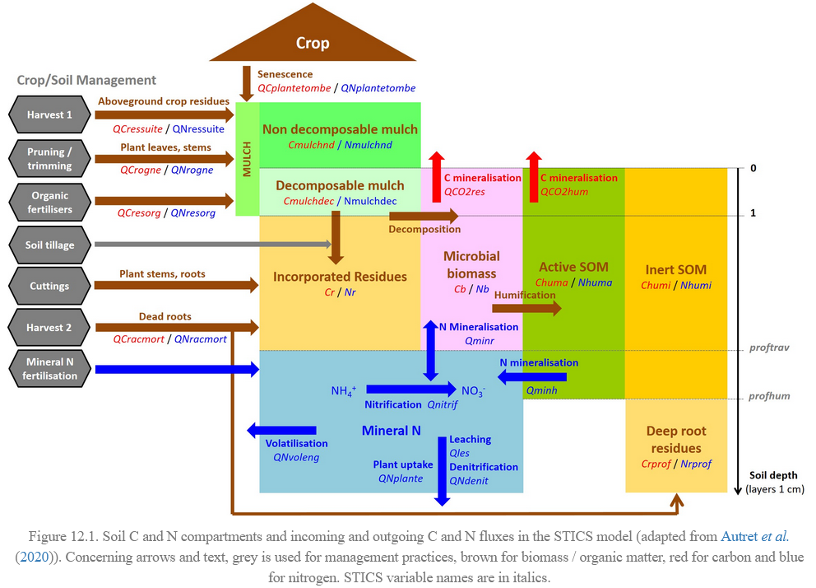
Pools and fluxes

Slide 20
Overview
Decomposition/mineralization
3 organic pools : residue, microbial biomass, humus (already present or newly formed)
rate dependent on C:N ratio, soil water content, temperature
induces mineralisation or organisation, which influences the mineral nitrogen pools
Humus also mineralized
Nitrification
transforms NH4 into NO3
part of the nitrified N is lost as N2O
Mineral nitrogen (NH4 or NO3) can be used by the plant (without selectivity)
Denitrification
NO3 is transformed in N2O
N2O can be reduced to N2
No N2 pool in STICS (gaseous loss which can be estimated from the N balance)

Slide 21
Residues decomposition and mineralization
Decomposition = f(Soil moisture and temperature (Normalized days), residues nature and C/N, available SMN)
C-CO₂
C-CO₂
Organic residues C/N
Microbial biomass
C/N
Humified organic matter C/N
(Nicolardot, 2001)
Mineral N
N
C
Successive regulation according to N availability (Giacomini et al, 2008).
Parameters according to nature and location of residues (contact with the soil)
Notes:
Les 4 regulations
Effet 1 : réduction de la vitesse de décomposition
Effet 2 : réduction du rapport N/C de la biomasse microbienne
Effet 3 : réduction du rapport N/C de l’humus néoformé
Effet 4 : apparition d’un ”Priming effect”

Slide 22
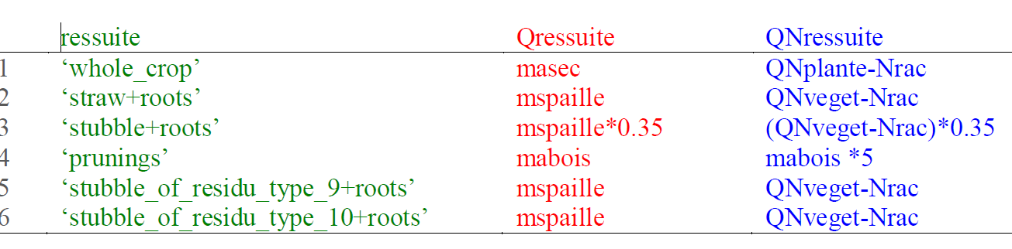
Direct input (tec file) or automatic input at harvest
Residue input
(Nicolardot et al, 2001; Justes et al., 2009)
Crop residues or organic wastes left as mulch or buried into the soil
/!\ (measured remaining biomass may include microbial biomass!)
Contributions of root residues at harvest = f(root system description option; root length, specific parameter)
Notes:
Les apports de résidus racinaires à la récolte ou à la fauche

Slide 23



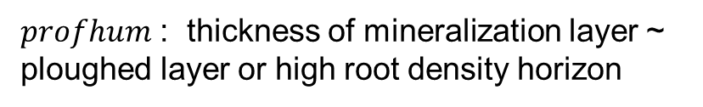
Humus mineralization (C and N)
Potential mineralization rate Vminh = K2*NHUM
K2 $=K2pot ∗ \frac{\sum_{z=1}^{profhum}{FH∗FTH} }{profhum }$
Stable
K2pot : 2 choices
Delphin, 1986 and Chaussod et al, 1986
Active
Clivot et al, 2017
Normalized days
$profhum$ : thickness of mineralization layer ~
ploughed layer or high root density horizon
Notes:
Pas très prédictive pour les sols sableux et non calcaires

Slide 24


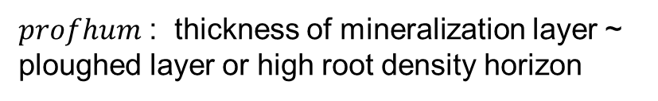
Humus mineralization (C and N)
Humus
Potential mineralization rate Vminh = K2*NHUM
$$NHUM∗ =Norg ∗Da(1) ∗PROFHUM∗(1−FINERT)$$
Stable
*$active fraction$
$$CHUM∗ =Corg ∗Da(1) ∗PROFHUM∗(1−FINERT)$$
Active
Da : only on the first layer in the 9.0 version , will be corrected on the v10
Soil mineral nitrogen pool
$profhum$ : thickness of mineralization layer ~
ploughed layer or high root density horizon
stable/total = 0.65
(Andriulo et al., 1999)
Notes:
Pas très prédictive pour les sols sableux et non calcaires

Slide 25
Gaseous N losses through volatilization, nitrification, denitrification
1) Empirical fertilizer efficiency approach of N losses:
immobilization – volatilization – denitrification
EFFN = 1 – NORGENG + NVOLENG + NDENENG
ANIT
=> Efficiency = f(fertilizer typology, crop N uptake rate)
2) Mecanistic approach
Description and simulation of volatilization, nitrification and denitrification processes
Notes:
Par processus, quelles sont nos interrogations (qui nous poussent éventuellement à proposer des modifications ?)
- dénit peu touchée dans son formalisme, mais :
1) des interrogations sur la valeur du Km de la relation de Michaelis-Menten qui relie l’activité dénitrifiante à la concentration en NO3 (labo, champs ; remanié ou pas...)
2) fonction température
- nit :
1) cosmétique pour distinguer potentiel et effet eau
2) minéralisation pour apports NH4 hors fertilisation
3) question de la cohérence avec STICS
- ratios
1) nit assez variable selon les sols, mais aussi en fonction de la teneur en eau
2) denit dépendant eau et nitrates
effets températures aussi...

Slide 26
Volatilization
Purely chemical process
Transform ammonium (NH4+) into gaseous ammonia (NH3)
Only available for organic manure
Tracks changes between 4 forms of ammonia compounds, one of them, NH3 in gaseous phase leads to volatilization.
Function of NH4+ concentration, temperature, evolving pH (high value = increase in volatilization), manure properties (Nmin, water content), soil tillage, soil porosity, wind speed...
(Génermont and Cellier, 1997)
Notes:
Par processus, quelles sont nos interrogations (qui nous poussent éventuellement à proposer des modifications ?)
- dénit peu touchée dans son formalisme, mais :
1) des interrogations sur la valeur du Km de la relation de Michaelis-Menten qui relie l’activité dénitrifiante à la concentration en NO3 (labo, champs ; remanié ou pas...)
2) fonction température
- nit :
1) cosmétique pour distinguer potentiel et effet eau
2) minéralisation pour apports NH4 hors fertilisation
3) question de la cohérence avec STICS
- ratios
1) nit assez variable selon les sols, mais aussi en fonction de la teneur en eau
2) denit dépendant eau et nitrates
effets températures aussi...

Slide 27
Nitrification, denitrification and associated N2O emissions
Options to activate (codenitrif, codedenit), but should be the default
Use default values first
Main uncertainty = denitrification potential
Active over profhum or prodenit
Notes:
Par processus, quelles sont nos interrogations (qui nous poussent éventuellement à proposer des modifications ?)
- dénit peu touchée dans son formalisme, mais :
1) des interrogations sur la valeur du Km de la relation de Michaelis-Menten qui relie l’activité dénitrifiante à la concentration en NO3 (labo, champs ; remanié ou pas...)
2) fonction température
- nit :
1) cosmétique pour distinguer potentiel et effet eau
2) minéralisation pour apports NH4 hors fertilisation
3) question de la cohérence avec STICS
- ratios
1) nit assez variable selon les sols, mais aussi en fonction de la teneur en eau
2) denit dépendant eau et nitrates
effets températures aussi...

Slide 28


N₂O module: nitrification
potential nitrification rate
regulation factors
nitrification rate
$$vnit=vnitpot.f_{NH4}.f_{pH}.f_{T}.f_{WFPS}$$
soil water content – aeration effect
NH₄ availability
pH effect
temperature effect
$$vnit=fnx ∗NH4 .f_{pH}.f_{T}.f_{WFPS}$$
Option 2 is more satisfying but option 1 works better in practice because the absence of saturation compensates for unrealistic high NH4 concentration at the soil surface!

Slide 29
N₂O module: denitrification
f(Norg & CsurNsol)
or vpotdenit
potential denitrification rate
denitrification rate
regulation factors
$$vdenit=vdenitpot.f_{N03}.f_{T}.f_{WFPS}$$
soil water content –aeration effect
NO₃ availability
temperature effect

Slide 30


N₂O module: N₂O emissions
N₂O emissions correspond to a constant or variable proportion of nitrification and denitrification rates
water content –aeration effect
N₂O emissions associated to nitrification
nitrification rate
$$N2Onit=z.vnit$$
N₂O emissions associated to denitrification
denitrification rate
$$N2Odenit=r.vdenit$$
pH, water content-aeration
and [NO₃] effects

Slide 31
N₂O module : options
option | parameter name | default value | other value
dependence on NH₄ for vnitpot | code_vnit | proportionality to NH₄ concentration | use of Michaelis-Menten function
temperature function | code_tnit | Gaussian function | linear function
N₂O ratio | code_rationit | variable with soil water saturation | constant
hourly WFPS | code_hourly_wfps_nit | yes | no
source of denitrification potential | code_pdenit | estimated using Norg and CsurNsol | vpotdenit
N₂O ratio | code_ratiodenit | variable with soil pH, WFPS and NO3 concentration | constant
hourly WFPS | code_hourly_wfps_denit | yes | no
NITRIFICATION
DENITRIFICATION

Slide 32
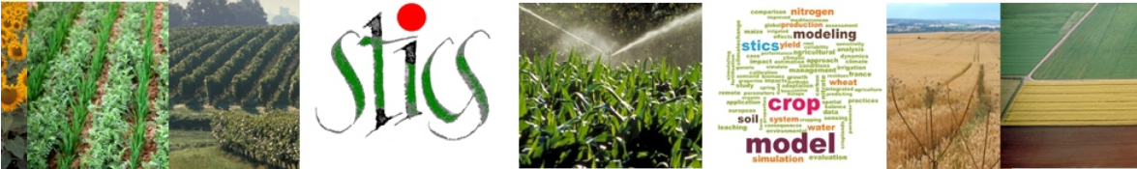
Thank you for your attention

